Slide 1

EXL Foundation Track Training
Final Project
Team 1
AMAN JAIN

Slide 2
Contents
Summary
Objective/Problem statement
Project Flow
Tools Used
My Contribution
Results
Conclusion

Slide 3
Summary
This project is an implementation of various machine learning models that is trained on a dataset that is based on employee attrition. This data is transformed and preprocessed to achieve better results. Further docker and jenkins are used for deployment.

Slide 4
Objective
The core objective of the project is to build a machine learning model that can predict the employee attrition, i.e., whether an employee is expected to leave an organization or not. Docker is used for deployment.

Slide 5
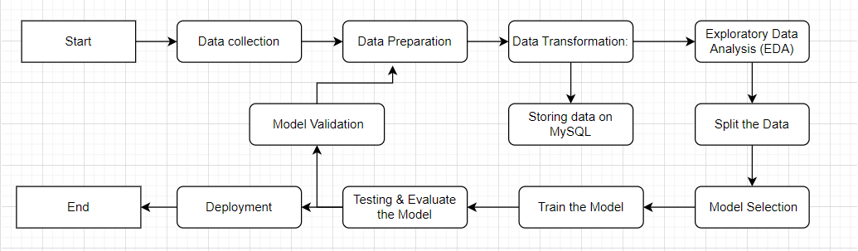
Project Flow

Slide 6
Tools Used
Google Colab
MySQL
VS Code
Git and Github
Docker
DockerHub
Jenkins

Slide 7
My contribution to the project
Introduction
Objective
Model Building
Data Preprocessing
Develop a linear regression model to predict accuracy accross different models.
Focus on creating a robust linear regression model utilizing historical data to establish predictive patterns.
Implement train-test split and normalization techniques to prepare data for model training.
Database Integration
Containerization and jenkins
Deployment Strategy
Integrate a database solution for efficient data storage and retrieval to ensure seamless data processing.
Dockerize the model to facilitate easy deployment and ensure consistency across different environments.
Created Jenkins pipeline for creation and building docker image
Utilize GitHub for version control and deployment, ensuring easy collaboration and updates.

Slide 8
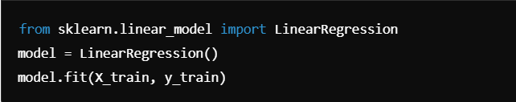
Linear Regression Model + Code snippet
Modeling
Model:
Linear Regression to predict [target variables]
Tools and Libraries
We utilized Scikit-learn for model implementation, while Pandas and Numpy were used for efficient data manipulation and processing.
Objective and Goals
Our goal is to minimize prediction errors by reducing the Mean Squared Error (MSE), ensuring accurate predictions of [target variable].
Notes:
Code Snippet: from sklearn.linear_model import LinearRegression
model = LinearRegression() model.fit(X_train, y_train)

Slide 9
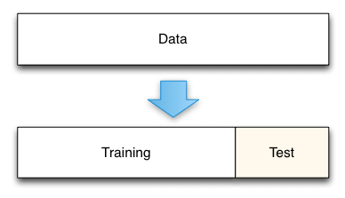

Data Preprocessing - Train-Test Split
Key Steps in Train-Test Split
80/20 Train-Test Split
Train on 80% of data, evaluate on 20%.
flow diagram showing how data flows from raw data -> preprocessing -> train-test split.
Notes:
Code Snippet:
from sklearn.model_selection import train_test_split X_train, X_test, y_train, y_test = train_test_split(X, y, test_size=0.2, random_state=42)

Slide 10
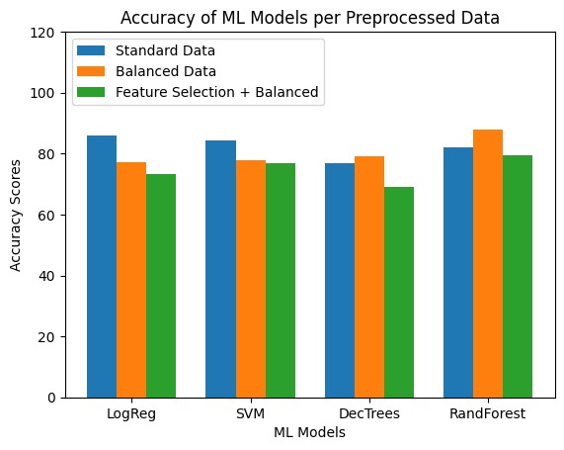
Results

Slide 11
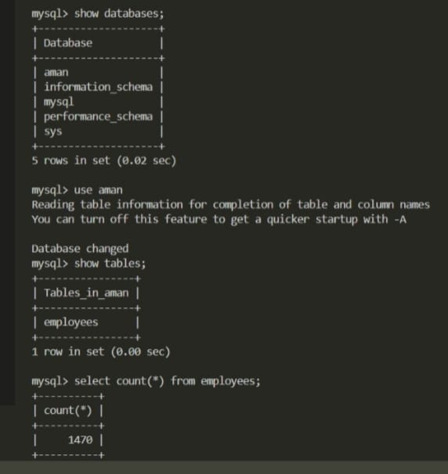
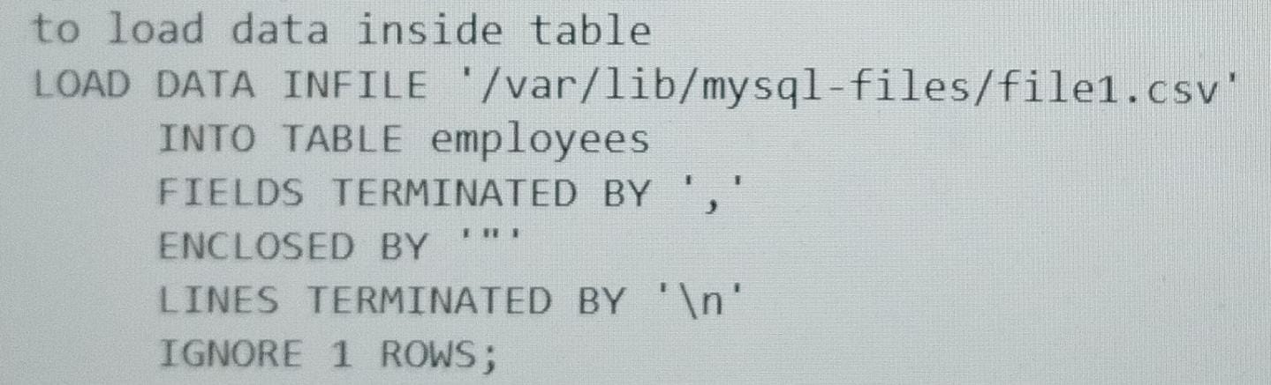
Database Integration
Benefits of Database Integration
Integration Approach with MySQL
Stores training and testing data for future use.
Facilitates efficient data retrieval for model retraining.
1)to import csv from local to container
Docker cp"C:\Users\aajai\Downloads\file1.csv" MySQL:/var/lib/mysql-files/file1.csv
to interact with mysql
Docker exec –it MySQL –u root -p
Connected Python to MySQL database for seamless data access.
Utilized SQL queries to retrieve and manipulate data.
Implemented secure authentication methods for database connection.

Slide 12
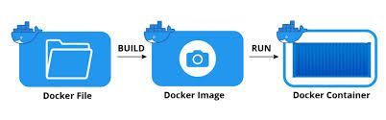
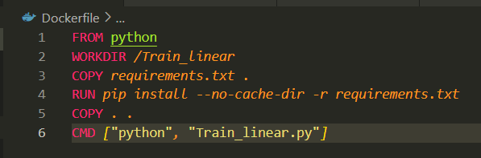
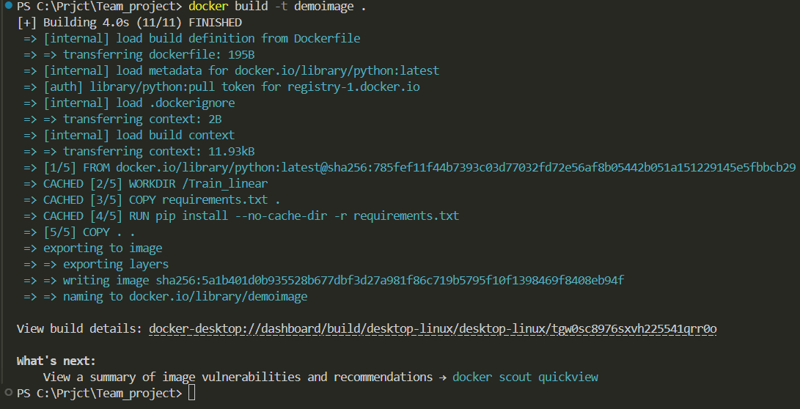
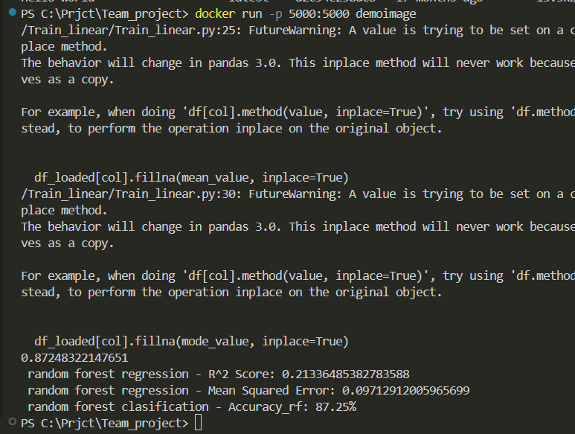
Dockerization
Key Benefits of Dockerization
Ensures consistency across different development, testing, and production environments by using containerized applications.

Slide 13
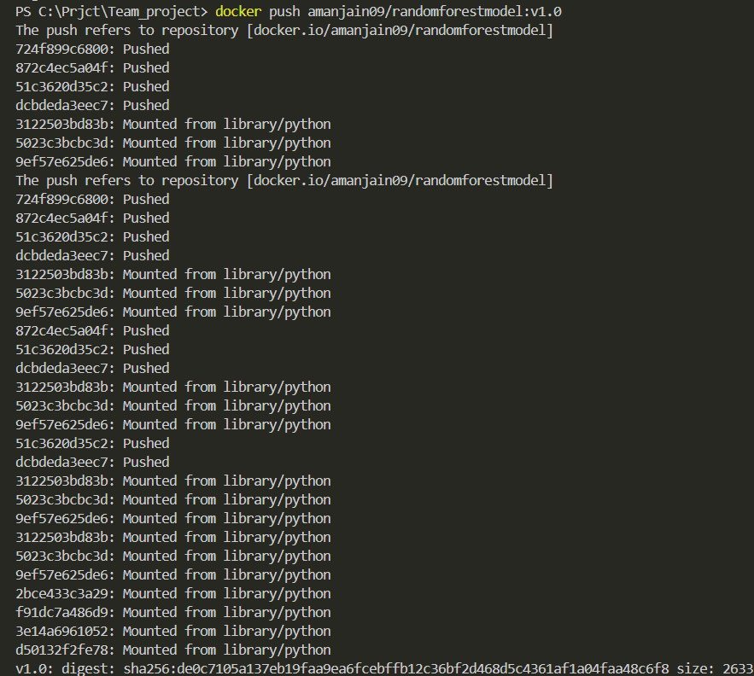

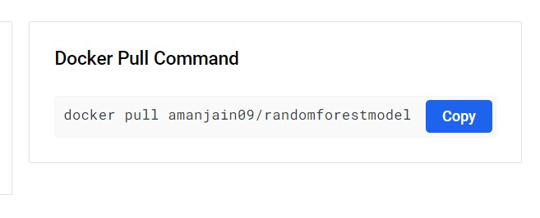
Pushing the Docker Image to docker hub
Technical Process
First verify the login credentials.
Push the image to docker hub
To access the image in other computer:
Give command
docker pull amanjain09/randomforestmodel:v1.0

Slide 14

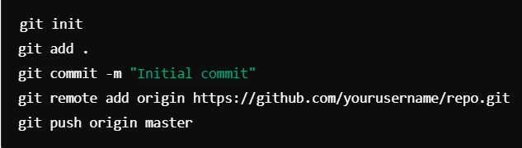
GitHub Deployment
Deployment
Key Steps in GitHub Deployment
Uploaded essential project files including the Dockerfile, model, and code to a GitHub repository to maintain version control and facilitate team collaboration.
Implemented GitHub Actions to automate continuous integration and continuous deployment (CI/CD), ensuring that any code changes are automatically tested and deployed efficiently.
Utilized branches and pull requests to manage different versions of the codebase, enabling a structured review process and reducing integration issues.
Configured secrets and environment variables within GitHub to securely manage sensitive data like API keys and deployment credentials.
Monitored deployments using GitHub's built-in features to track successes and failures, providing insights for further optimization.
Notes:
Key Commands:
git init
git add .
git commit -m "Initial commit"
git remote add origin https://github.com/yourusername/repo.git
git push origin master

Slide 15
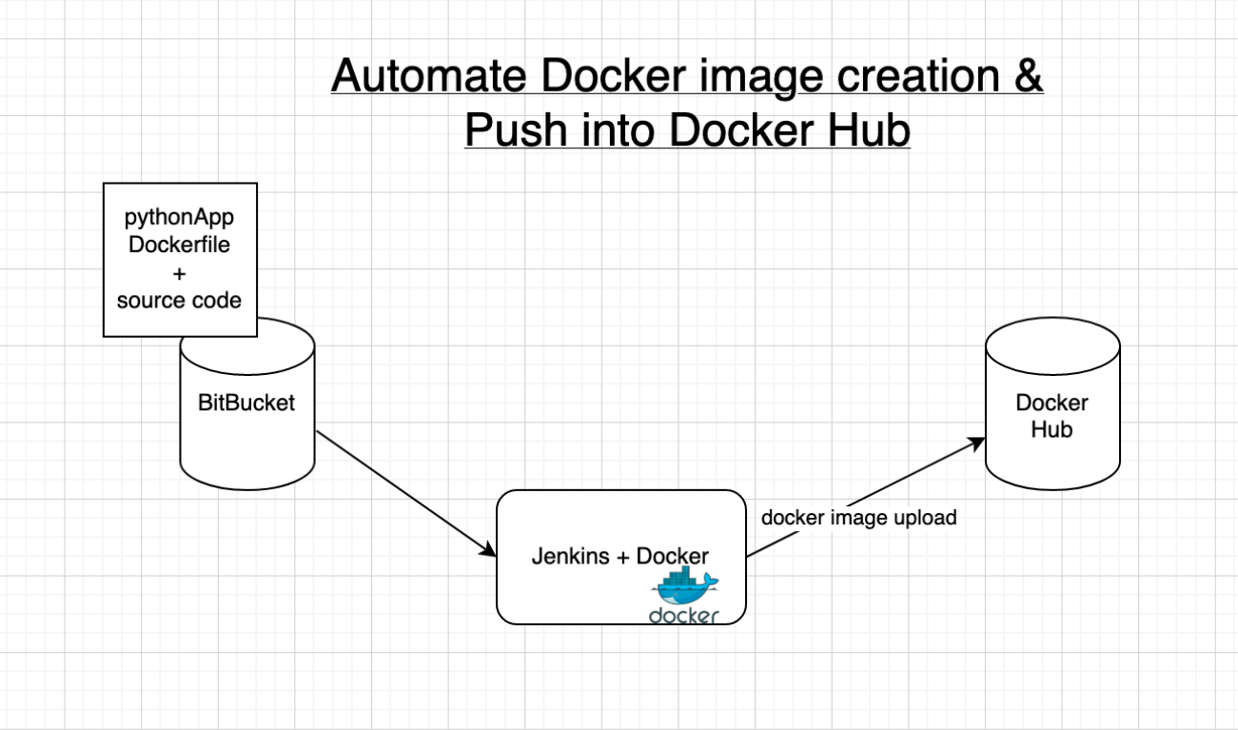
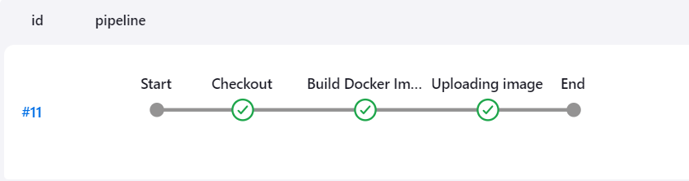
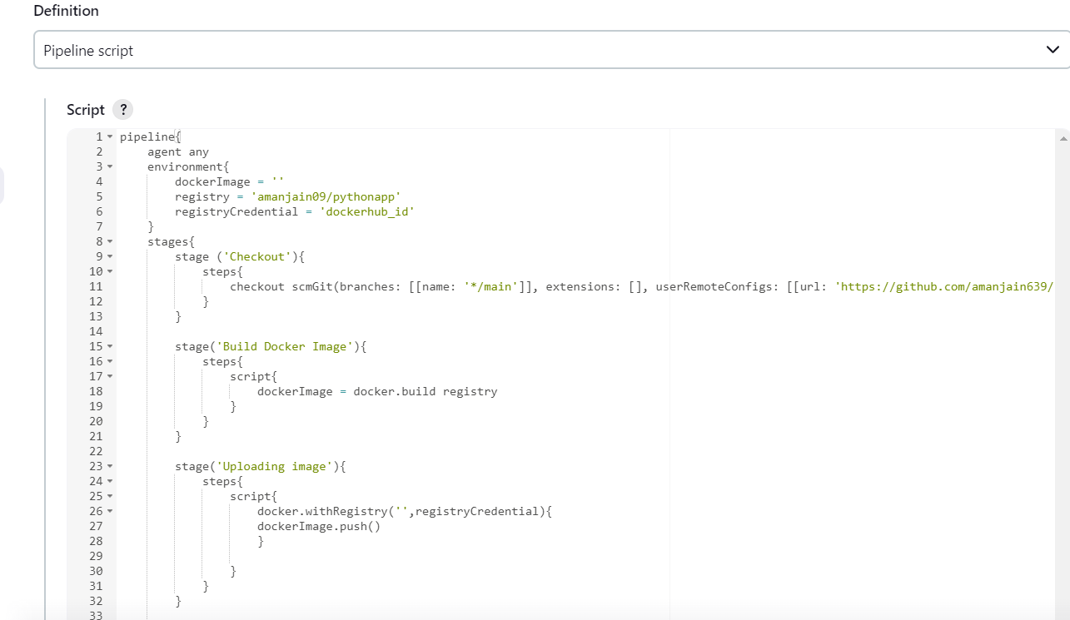
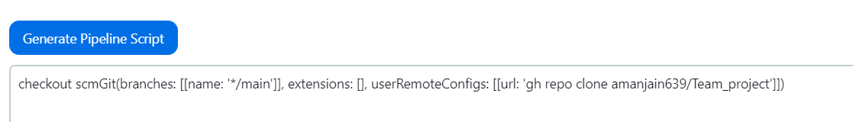
Jenkins
Key Benefits of Jenkins
Automating builds
Automating Docker image creation
Automating Docker image upload
Automating Docker container provisioning
Stages of pipeline:

Slide 16
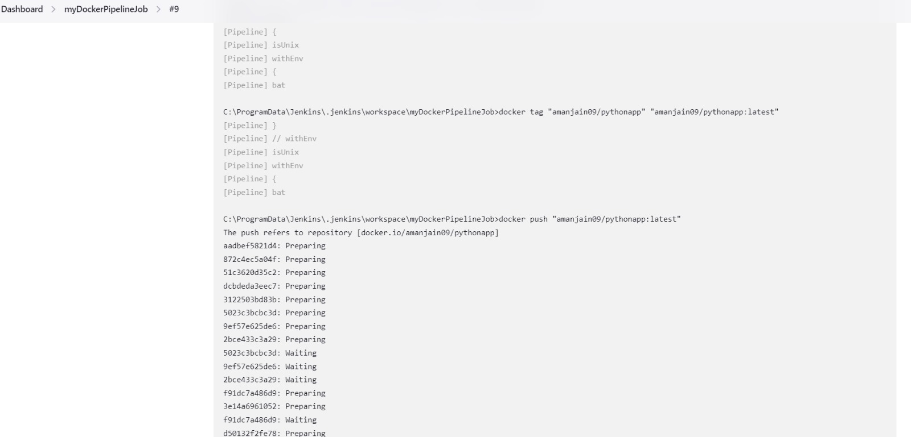
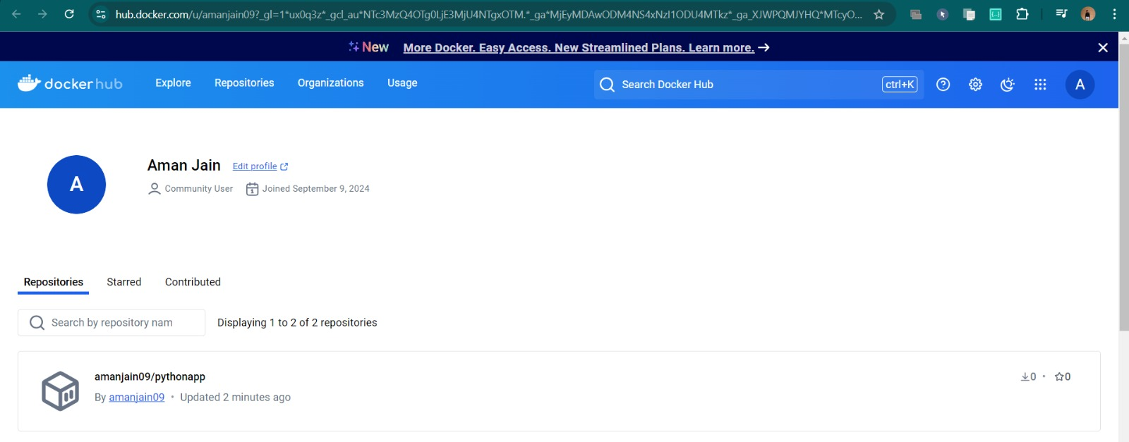
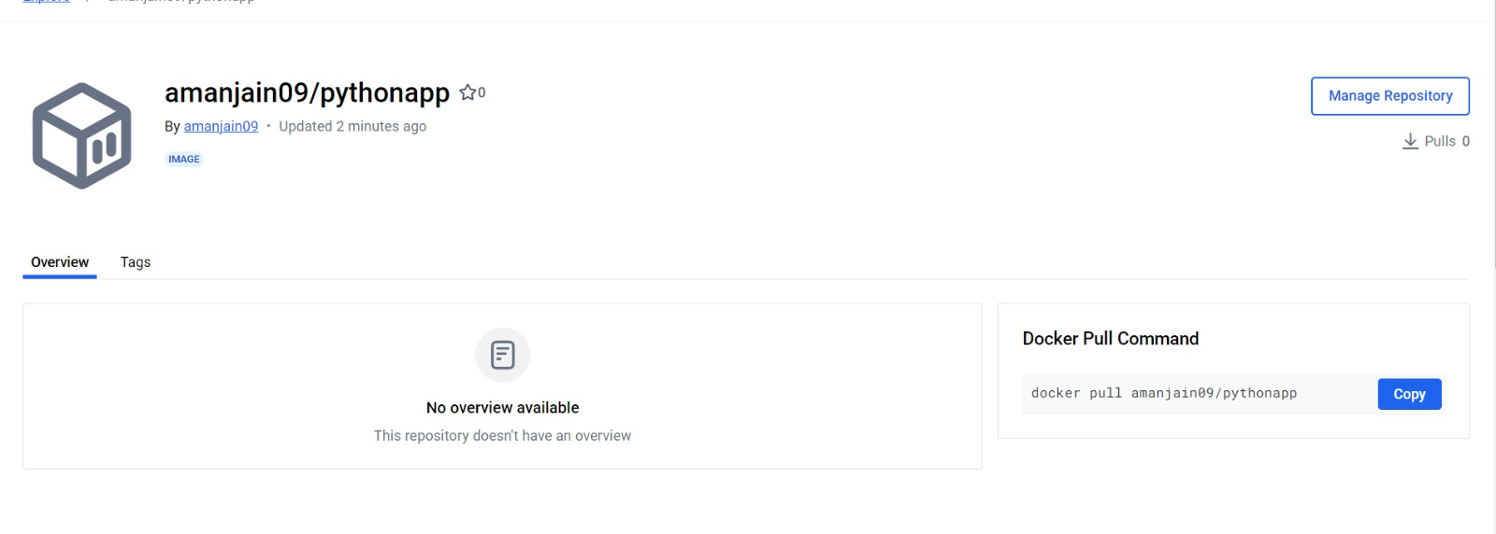
Jenkins
Technical Process
After script done,click on apply
Click on Build Now
Pipeline completed successfully
You can see on dockerHub also
Pull Command:docker pull amanjain09/pythonapp

Slide 17
Conclusion
Reflection
“
Successfully developed and deployed a regression model.
Integrated with a database for data management.
Used Docker to containerize the application.
Deployed the entire project on GitHub for version control and future collaboration.
Created Jenkins Pipeline for automating Docker image creation and push docker image into Docker Hub
Aman Jain

